Slide 1
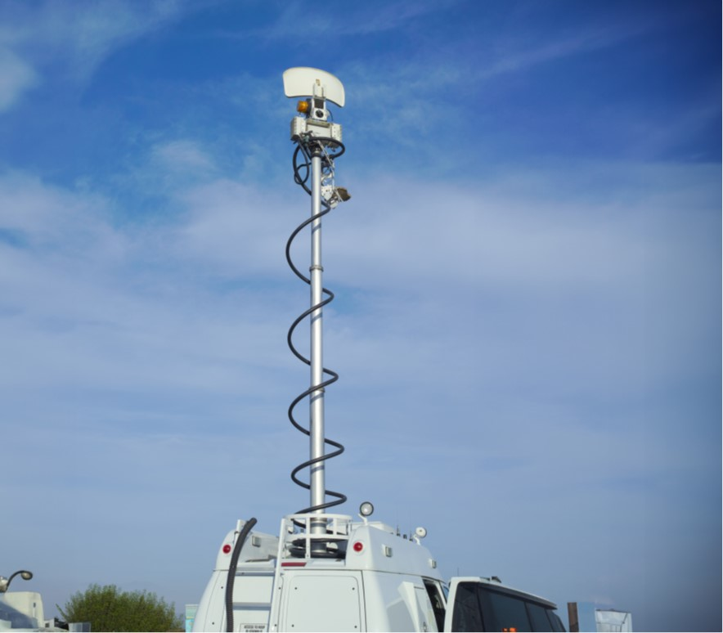
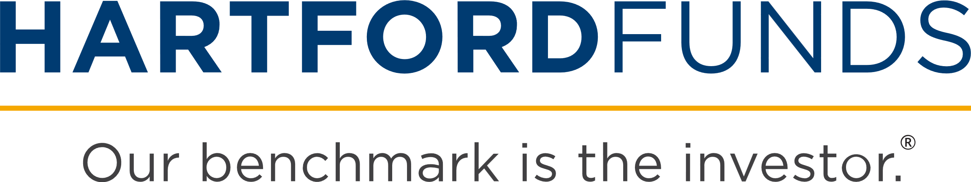
Media
Replay
© 2025 by Hartford Funds
Copyright © 2025 by Hartford Funds
Notes:
Good morning/afternoon everyone. My name is __________, and I’m a [insert title] with Hartford Funds. Thank you for taking time out of your schedule to attend our Media Replay event.
We get insights on consumer behavior, which means the way we act, think and make decisions, from an institution that you’ve probably heard of—The Massachusetts Institute of Technology (MIT).
Within MIT is the AgeLab, where researchers study the way that we think, act and make decisions, and actually, for purposes of our talk today, they examine mistakes we may be prone to make based on the media’s influence.
To get us started, I want you to think about two people, one who you probably heard of before and maybe one who you haven't. Let's start with the person that maybe you haven't heard of before. His name was Walter Lippmann. Anybody ever hear of Walter Lippmann? (Wait for response)
Well, Walter Lippmann was probably the most famous journalist in the United States in the 1920s and 1930s. He literally wrote the book on how media influences public opinion. In fact, the name of the book he wrote in 1922 was called Public Opinion. Walter Lippmann, by the way, also coined the terms “stereotype” and “Cold War.” His premise on how media impacts public opinion was that there's the world outside and there are the pictures in our heads. And media is the bridge between the two.
Why is this important? Because sometimes the pictures that we form in our head based on the news aren’t always accurate. This may not happen because of intentional misrepresentation. Sometimes it happens because events have to be compressed into very short messages. Let's face it, we all don't have the time available to us to contemplate every single thing that goes on around us. So, what do we depend on? We depend on snippets, sound bites, and the lead story of the day, which is compressed and squeezed in to a 30-minute broadcast on the evening news. Lippmann also stated, “Media doesn't tell you what you think, but it tells you what to think about.” So, media has an intense influence on our perceptions.
We're going to talk today about how Lippmann’s views impact our investment decision-making process.
The second person I want you to think about tonight is a guy you’ve probably heard of. His name is Mark Twain. Mark Twain was the guy who famously said, "History may not repeat itself, but it certainly rhymes.“

Slide 2

Déjà News
The Economy’s High Blood Pressure
The New York Times
July 9, 1978
Dow Jones: 817
There’s No Way Out of this
Unemployment Crunch
U.S. News & World Report
March 14, 1983
Dow Jones: 1,114
Is the US Going Broke?
TIME
March 13, 1972
Dow Jones: 929
Exploding Federal Debt—Why so Dangerous?
U.S. News & World Report
October 22, 1984
Dow Jones: 1,217
Bear Holds Bull
to a Standstill
The New York Times
June 1, 1960
Dow Jones: 624
Is the Recession Over?
The New York Times
March 22, 1992
Dow Jones: 3,276
Stocks Are Spooked That Trump's Tariffs Will Trigger a Recession
The Wall Street Journal
March 11, 2025
Dow Jones: 41,433
Joblessness Is
Here to Stay
Newsweek
December 21, 2009
Dow Jones: 10,414
Crisis of Today...or Yesterday?
War, Inflation Knock World Economy Off Balance
The Wall Street Journal
September 23, 2022
Dow Jones: 30,076
Coming Soon: “Invasion of the Walking Debt”
The New York Times
July 31, 2011
Dow Jones: 12,132
World Economy Shudders as Coronavirus Threatens Global Supply Chains
The Wall Street Journal
February 24, 2020
Dow Jones: 27,960
A New Economic Era for China Goes Off the Rails
The New York Times
January 7, 2016
Dow Jones: 16,514
Source: Google Finance, 2024
Notes:
Today’s headlines may seem scary—so scary that “playing it safe” and not losing your money may seem like the only rational strategy. However, these headlines aren’t exactly “new” news. In the past few decades, we have seen repeating patterns of crises including unemployment, economic downturns, and national debt concerns.
Yet, despite all these crises, the Dow Jones Industrial Average rose from 679 points in 1959 to over 44,000 in 2025.¹ In fact, long-term investors who stayed the course and did not lose sight of their financial goals have been rewarded.
With the market drop in 2025, many people are getting anxious about their investments again. For example, the Dow dropped to 41,433 in March 2025. Despite the uncertainty, investors should consider that the US has experienced 26 bear markets (a market drop of 20%) since 1929.² Our recovery record? 26 for 26. While we can’t predict the future, as Warren Buffett has said, “It’s never paid to bet against America.”
¹ Data Source: Google Finance, 2025
² Ned Davis, 2024

Slide 3
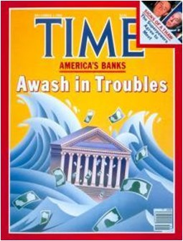
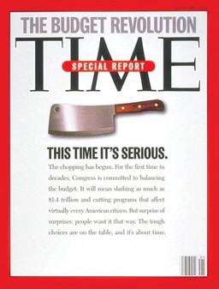
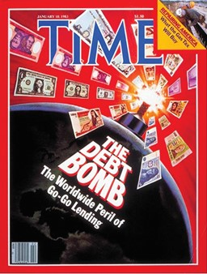
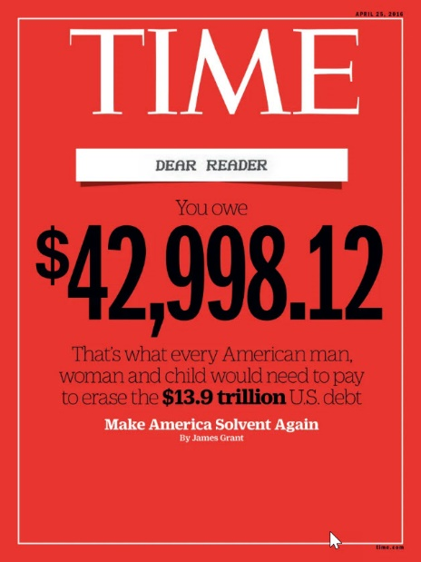
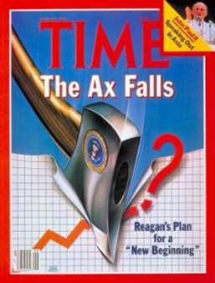
Debt, Debt, and More Debt
12/3/1984
5/22/1995
1/10/1983
4/25/2016
3/2/1981
From TIME. ©
Notes:
Here’s a subject we hear a lot about these days, “Debt, Debt, and More Debt.” (read some of the headlines)
It’s one of the biggest concerns I hear about from investors.
[Optional: Ask audience to guess which is the oldest cover]
(click to reveal dates) The oldest cover is March 2, 1981, “The Ax Falls”
The latest cover here is from 2016. But I think we’d agree that we wouldn’t be surprised if we saw any of these covers printed today.

Slide 4




Geopolitical Risks
10/6/1980
3/28/2022
7/28/2008
From TIME. ©
1/14/1980
6/7/1999
Notes:
Finally, there always seems to be a geopolitical crisis going on somewhere.
[Read a few of the headlines]
The oldest was the Moscow’s Bold Challenge. The most recent was the Ukraine Russia conflict in Nov. 2022.
The main point about these Time magazine covers is to point out the media repeats the same themes over and over again.
By the way, out of the covers I shared, how many were positive?
None.
And after seeing these covers, when do you think it would have been the best time to invest?
Never? These covers create negative pictures in our heads that can dampen our view of the market.

Slide 5

Agenda
Anxiety
Instinctual Behavior
Staying Above the Fray
Copyright © 2025 by Hartford Funds
Notes:
Here are three areas we’ll consider:
Anxiety
Instinctual behavior
Staying above the fray
5

Slide 6

Anxiety
Notes:
Let’s begin with our analysis in the first area: anxiety.

Slide 7
Stress: Anything that disrupts homeostasis
Fear: Clear and present danger
Anxiety: Anticipation of a clear or present danger, whether real or not
  Crisis: A stage in a sequence of events at which the trend of all future events depends
Notes:
[read slide]
Homeostasis, from the Greek words for "same" and "steady," refers to any process that living things use to actively maintain fairly stable conditions necessary for survival.

Slide 8
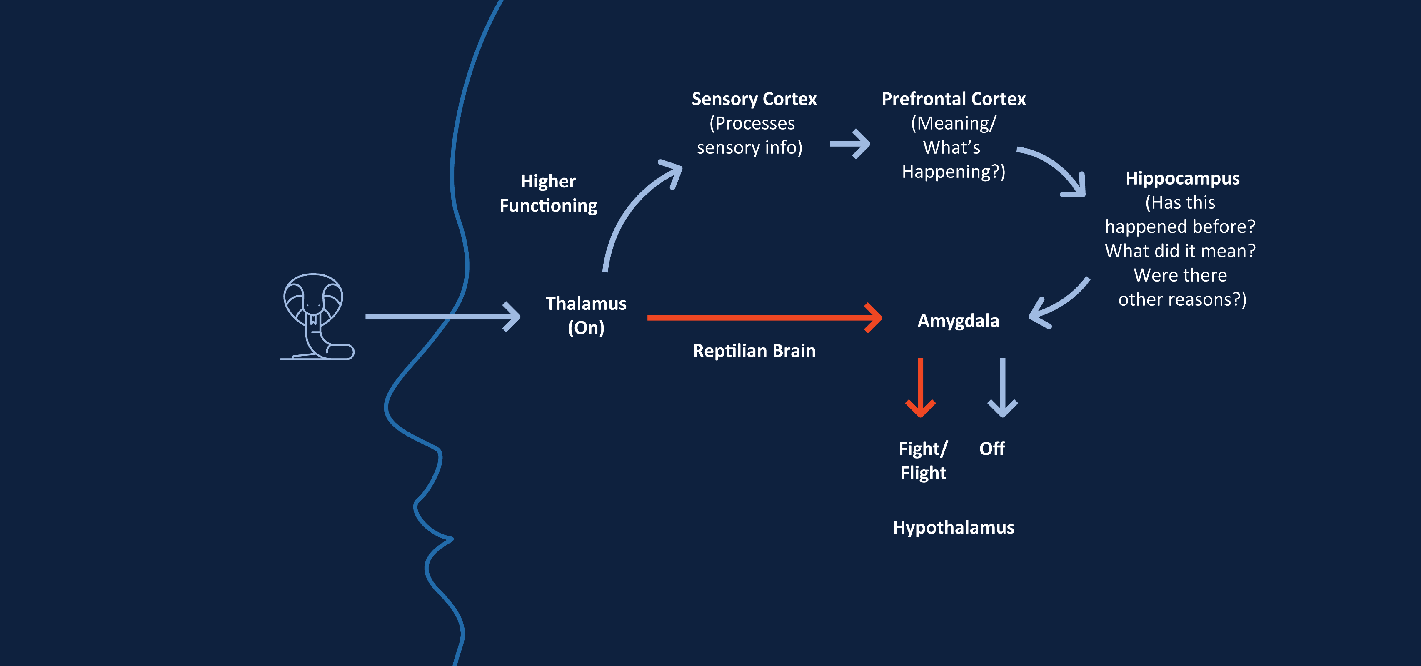

The Brain as a Fear Factory
Source: MIT AgeLab
Notes:
When there's a threat, like noticing a snake, our thalamus activates. It receives sensory information (sights, sounds, touch, etc.) from the environment and send this info simultaneously to two main pathways – the low road and the high road.
The low road is always activated first because it is faster and helps you react to potential danger immediately.
The high road takes longer because it involves more processing in the sensory and prefrontal cortex.
Let’s look at each pathway a bit closer.
The Low Road (Fast but Primitive)
Sensory input → Thalamus → Amygdala (aka the monkey mind)
Thalamus: Acts as a sensory relay station and influencing how the brain processes and reacts to potential threats. Sends sensory info to both the high road and low road simultaneously.
Amygdala: Acts as the brain’s “alarm system.” When it detects a potential threat (real or imagined), it activates the body’s fear response.
Hypothalamus: Turns on the body’s stress response—the fight or flight response. This activation leads to increased heart rate, rapid breathing, sweating, muscle tension, etc.
This is a quick, automatic pathway designed for survival.
It’s a first responder and doesn’t try to determine if it’s a false alarm
Purpose: Triggers an immediate emotional response (e.g., fear) before the brain has fully processed the situation
Example: Seeing a shadow that might be a snake—your amygdala triggers fear immediately
The High Road (Slow but Rational)
Sensory input → Thalamus → Sensory Cortex → Prefrontal Cortex → Hippocampus → Amygdala → Hypothalamus
Sensory Cortex: Processes sensory information—everything you see, smell, hear, touch, and feel.
Prefrontal Cortex: Handles higher-level thinking, reasoning, decision-making, and self-control.
Hippocampus: Uses memory to evaluate the context of a situation.
Amygdala: With the context provided by the hippocampus, it assesses the emotional significance of the threat.
Hypothalamus: Turns off the fight-or-flight response if the threat is deemed non-threatening.
Purpose: To analyze the sensory input and determine if the threat is real
Example: Realizing that the shadow is just a rope after closer inspection
When facing a threat, the low road can dominate, causing the amygdala to overreact to minor or imagined threats before the prefrontal cortex has time to rationalize.
Given enough time, the prefrontal cortex and hippocampus can help calm the amygdala’s fear response by logically assessing whether a threat is real or imagined.
Now that we understand how our reptilian brain works, let’s look at what can trigger it.
Source: MIT AgeLab, The Ultimate Guide to the Brain for AP Psychology, albert.io, 9/24/16

Slide 9

The Daily Media Storm
The average American spends
7 hours &
3 minutes
looking at a screen everyday
Screen Time Statistics: Average Screen Time in US vs. the Rest of the World, Comparitech, 3/15/23
Notes:
The average American spends 7 hours and 3 minutes looking at a screen every day.¹ And we consume lots of news on our phones.
A 2018 study found that those 38+ spent 30,103 minutes a year watching news to be exact.²
¹ Screen Time Statistics: Average Screen Time in US vs. the rest of the world, Comparitech, 3/20/24
² Source: Millennials on Millennials: TV and Digital News Consumption, Nielsen, 2018. Most recent data available.

Slide 10
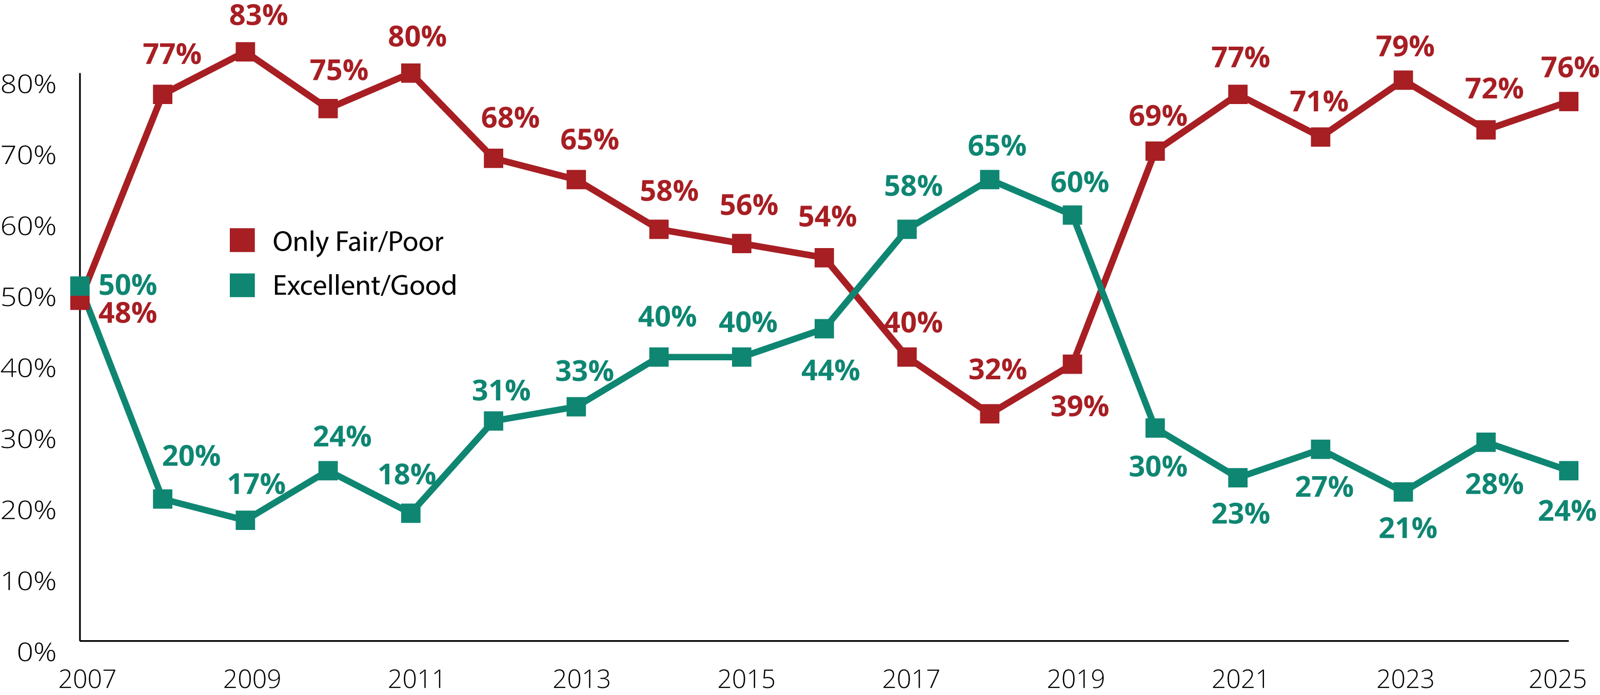
Views of Economy Have Turned Negative
% who say that economic situation in the country is...
Source: Summer 2020 Global Attitudes Survey, Pew Research Center, 9/3/20 and 2025 Pew Research Center’s American Trends Panel, Pew Research Center, 2025
Notes:
From 2009 to the beginning of 2020, we experienced the longest bull market ever.¹ Most Americans were feeling good about the economy—but then, the pandemic dampened our optimism.
The S&P 500 Index rebounded from two bear markets in 2020 and 2022. And despite the market reaching all-time highs in 2025, 76% of people surveyed still felt economic conditions were only fair/poor.²
¹Stocks are at an all-time high. Here’s what stopped the last 12 bull runs, CNN, 4/23/19
²Pew Research Center’s American Trends Panel, Pew Research Center, 2025

Slide 11

Instinctual Behavior
Notes:
Now, let’s move on to instinctual behaviors.

Slide 12


Anxiety’s Impact on Behavior
Investing attention in the negative
If it’s not clear, it must be bad
Risk aversion: “Just don’t lose it!”
Notes:
The Anxiety Effect
Insights from Dr. Joseph Coughlin, Founder and Director of MIT AgeLab
The MIT AgeLab provides insights to Hartford Funds about consumer behavior and decision-making, and trends in demographics, technology, and lifestyle. These trends impact the way people do business with financial-services providers and how they use financial advice.
Investing Attention in the Negative
Anxious investors are more apt to devote their attention to information that is negative.
When faced with the choice between information that could potentially inspire optimism versus information that paints a dismal future, the anxious client will opt to focus on the latter.
If It’s Not Clear, It Must be Bad
To further complicate matters, anxious investors process ambiguous information differently. Information that isn’t crystal clear is more likely to be perceived as bad or even threatening, fueling their pessimism.
Risk Aversion: “Just Don’t Lose It!”
Today’s investor is more likely to say, “Just don’t lose it!” rather than, “How do we grow it?”
An anxious investor’s main objective is to reduce current risk—not to plan ahead. Instead of making decisions based on long-term financial objectives, they will act upon how they feel in the moment.
*Above are all Insights from Dr. Joseph Coughlin, Founder and Director of MIT AgeLab
The MIT AgeLab

Slide 13
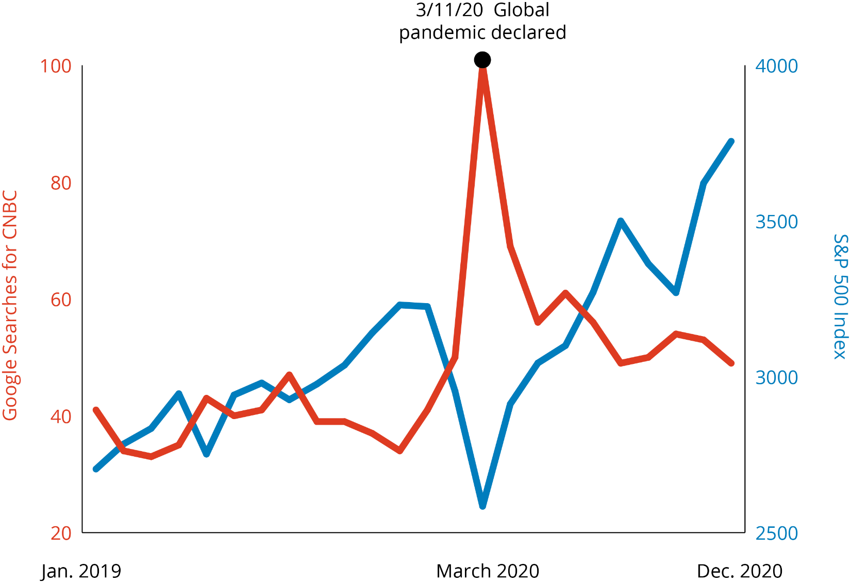
We Seek Negative Information
Google searches for CNBC¹
S&P 500 Index²
Google Searches for CNBC vs. S&P 500 Index
PAST PERFORMANCE DOES NOT GUARANTEE FUTURE RESULTS.
Index descriptions are included on last slide. For Illustrative purposes only. Indices are unmanaged and not available for direct investment.
Google Trends Methodology: Google Trends enables you to compare the world’s interest in various internet topics; it shows how frequently topics have been searched on Google over time. The numbers on the graph reflect how many searches have been done for a particular term, relative to the total number of searches done on Google over time. They don’t represent absolute search volume numbers, because the data is normalized and presented on a scale from 0-100. Each point on the graph is divided by the highest point, or 100. A rising line for a search term indicates a growth in the term’s popularity.
¹Data Source: Google Trends, 12/23
²Data Source: Factset, 12/23
Notes:
Here’s a graph of Google search trends for the term “CNBC” and their correlation to the performance of the S&P 500. See when searches for CNBC were the highest? In March of 2020. That’s when the World Health Organization declared the global pandemic.
On March 16, 2020, The S&P 500 dropped 12%. The Dow Jones Industrial Average fell 2,997 points (11%) to 20,188. A headline read, "Dow tumbles nearly 3,000 points, the worst point drop in history.”¹
This graph conveys that we need to be mindful of our tendency to invest attention in the negative, which can cause us to miss certain investment opportunities. For example, when the Dow dropped to 20,188 in March 2020, many investors probably threw in the towel and got out of the market for good. In February of 2025, the Dow was over 44,000.²
A crisis can throw the markets, and investors, for a loop. Let’s see how many we’ve encountered over the last couple decades.
¹ Largest one-day point losses of the Dow Jones Industrial Average (DJI) from 1897 to June 2023, Statista, 1/3/24
² Yahoo Finance, 2025

Slide 14
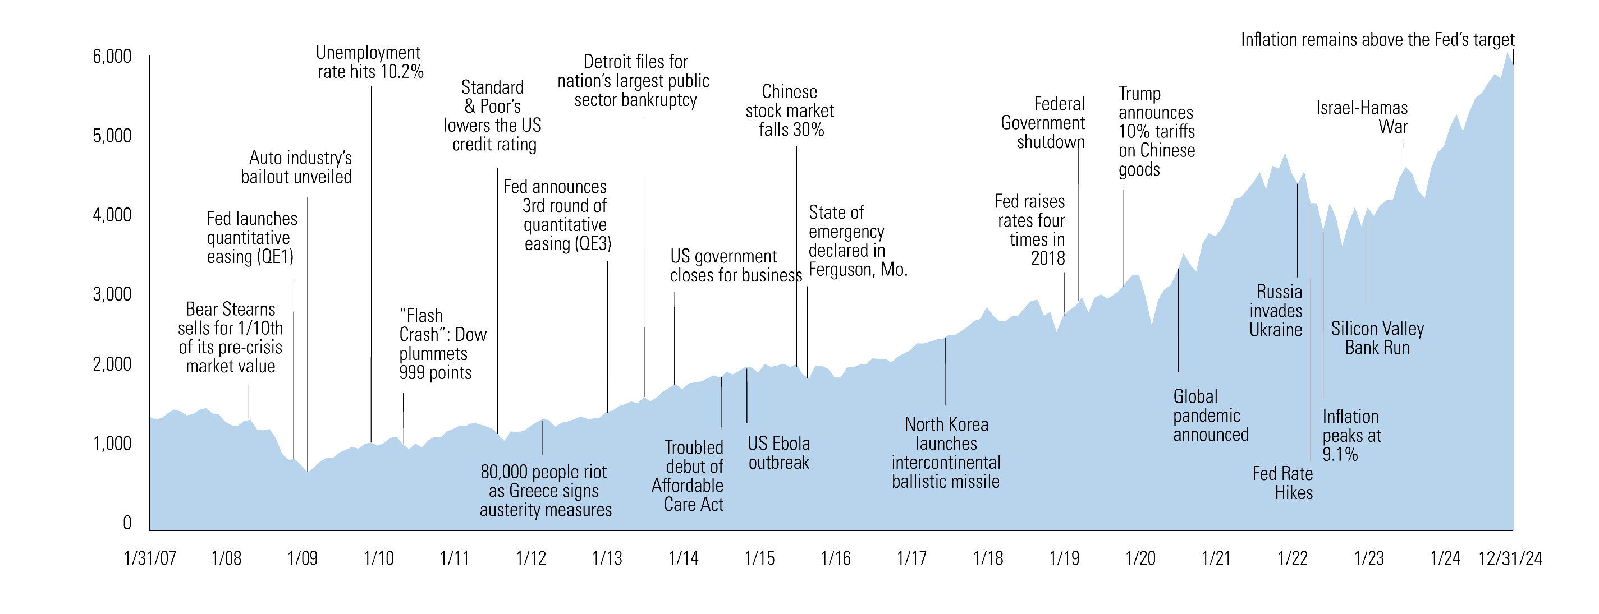
If It’s Not Clear, It Must Be Bad (It’s Always Something)
S&P 500 Index¹
¹Source: FactSet 12/24
PAST PERFORMANCE DOES NOT GUARANTEE FUTURE RESULTS.
Index descriptions are included on last slide. For Illustrative purposes only. Indices are unmanaged and not available for direct investment.
Notes:
The MIT AgeLab tells us that in an anxious state we believe that if something’s not clear, it must be bad. The blue mountain chart is the S&P 500 Index. We took select headlines that maybe you remember: Lehman Brothers or Washington Mutual Bankruptcy, the unemployment rate was 10.2 percent, the “flash crash,” interest rate hikes, inflation, and so on.
When crises like these hit, we often feel like don’t know a lot about them. And the MIT AgeLab says when things seem unclear, we view them as bad.

Slide 15

Risk Aversion: Just Don’t Lose It!
Notes:
Suppose you’re walking down the street and there's a $20 bill lying on the sidewalk. You bend down to pick up the bill and look around. No one’s nearby, and you have no idea where it came from—so you put it in your pocket. You continue down the street, whistling and thinking, This is my lucky day. That was pretty cool!
Ten minutes later you reach for that $20, but it’s not in your pocket. You lost it.
The pain of losing that $20 will be two to three times greater than the excitement of finding it. Even though from a purely economic standpoint, you're no better or worse off than when you started walking down the sidewalk, right? This is known as “loss aversion.”
Psychologists Daniel Kahneman and Amos Tversky developed a theory that is called Loss Aversion
In 1979, Drs. Kahneman and Tversky gave their students a simple survey, asking whether or not they would accept a variety of different bets
The professors noticed that when their students were offered a gamble on the toss of a coin in which they might lose $20, they demanded an average payoff of at least $40 if they won
They concluded that the pain of a loss was approximately twice as potent as the pleasure generated by a gain
As Kahneman and Tversky put it, “In human decision making, losses loom larger than gains.”
So there is a scientific reason why investors tend to prefer avoiding losses to acquiring equivalent gains. Simply put, it’s better not to lose $20, than to find $20.
Source: What Is Loss Aversion? scientificamerican.com, July 2016. Most recent data available.

Slide 16
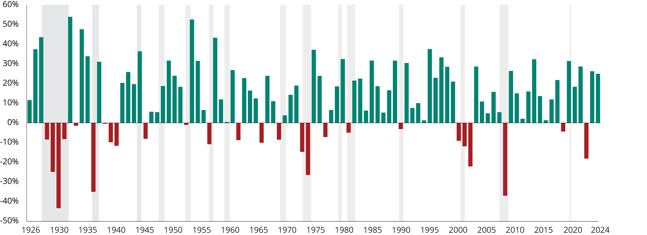
Risk Aversion: “Just Don’t Lose It!”
Recessions
Average Annual Returns: S&P 500 Index 1926–2024
PAST PERFORMANCE DOES NOT GUARANTEE FUTURE RESULTS.
Source: Morningstar, 12/24. Indices are unmanaged and not available for direct investment.
Notes:
The third thing the MIT AgeLab tells us that we're likely to do during period of anxiety is become very risk averse. We're more concerned about not losing our money than making money.
Let me ask you a question about this graph. Which is there more of on this chart, red or green? (pause) Green, right? By a lot or little? A lot. These bars are the individual market returns each and every year since 1926. There are 72 positive green bars and 26 red ones.
So why is it that this one (point to red bar in 2008) and this one (point to red bar in 2022) can dominate our thinking about investing. It’s because of the pain of a loss that we discussed earlier. The 2008 drop that lost 37% and the 18% drop in 2022 are hard to forget. And that's maybe why we may be over allocated to positions that may be the less risk averse.
To take this concept a bit further. What was the risk or what was the opportunity where these markets earn more than 20 percent versus when they lost more than 20 percent? In 38 of those years, you would have earned more than 20%. And only 6 years lost more than 20%.
The chance that someone in a couple (age 65) today will live to age 92 is 50%.¹
Why this is important? Because our portfolio should be allocated to give our assets the probability to last as long as we will.
¹Source: American Academy of Actuaries, 2025

Slide 17
“I Can’t Take It Anymore!”
30%+ Drops in the S&P 500 Index 1960–2024
-36.1%
11/29/68-5/26/70
Interest rates rose above 9%
Vietnam War
--48.2%
1/11/73-10/3/74
Middle East oil embargo
Watergate
-33.5%
8/25/87-
12/4/87
Black Monday: the Dow Jones Industrial Average dropped 22%
in a single day
-36.8%
3/24/00-
9/21/01
Dot-com bubble
Accounting scandals
9/11
-33.8%
1/4/02-10/9/02
WorldCom collapse
Tyco executives indicted
Ford closes five plants
-56.8%
10/9/07-3/9/09
Housing bubble
Financial crisis
-33.9%
2/19/20-3/23/20
Global pandemic
Source: Ned Davis Research, 12/24
Notes:
Now let's talk about seven market periods when it would’ve been really easy to move all of our money to cash investments to protect against further loss. We define these panicked markets as periods that cause people to say, "I just can't take it anymore, the market is down more than 30 percent. Just get me out! I’m going to hit the panic button because I want to escape the equity markets and avoid losing more money.”
You may not remember the years, but you might remember the Middle East oil embargo, when you could only purchase gasoline on alternating days, according to whether the last digit on your license plate was even or odd and the gas lines went around the block. How about the dot com bubble or Black Monday when the market dropped more than 20% in one day? The one thing these seven periods had in common is that the market lost more than 30% during these times.

Slide 18
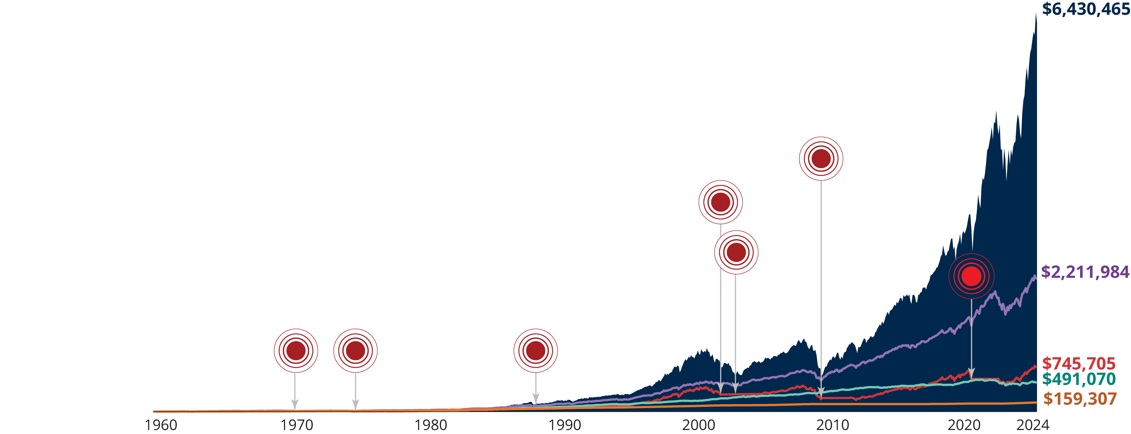
The Price of Panic
$10,000 Invested in S&P 500 index 1/1/60–12/31/24
n Equity Investor
n Balanced Investor
n Bond Investor
n Reactionary Investor
n Cash Investor
Market drop of 30% or more
Initial
Investment
$10,000
PAST PERFORMANCE DOES NOT GUARANTEE FUTURE RESULTS. Equity returns are represented by the S&P 500 Index. Bond returns are represented by 1960-1975: IA SBBI LT Government Index, 1976-present: Bloomberg US Aggregate Bond Index. Reactionary returns indicate the results of an investor who invested in S&P 500 Index, moved 100% into 30-Day T-Bills each time the market dropped 30% and then moved 100% back into S&P 500 Index two years later. Balanced returns are represented by 50% S&P 500 Index and 50% IA SBBI US Long Term Bond Index. Cash returns are represented by 30-Day T-Bills. Data Source: Ned Davis Research, 12/23. For Illustrative purposes only. Indices are unmanaged and not available for direct investment. Index descriptions are included on last slide. US Treasury securities are backed by the full faith and credit of the US Government. Equities and bonds are subject to risks and may not be suitable for all investors.
Notes:
Now let’s a look at five hypothetical investors that went through these seven panic markets from 1960-2024. All five of these investors invested $10,000 in 1960.
The first investor is the cash investor, represented by the orange line. This investor invested his $10,000 in cash investments. They thought, "I don't want to take any risk, and don't want to be in the markets. I just want to hide it away in safe assets.” They enjoyed some high interest rates that helped their cash investments. During the 1980s short-term interest rates hit 16%. People were getting some pretty good returns on cash back in the 1980s. At the end of last year, the cash investor ended up with [read slide].
The second investor we’ll discuss is the equity investor, represented by the dark blue area. This investor invested all their money in the markets and never took it out through any of the ups and downs. They experienced wild volatility throughout this period. But this investor got the most money of anyone. This investor’s $10,000 grew to [read slide].
The green line represents the Bond investor who said, “I’ll only invest in fixed income.” Until 2022, this investor enjoyed 30 previous years of falling interest rates which tend to be beneficial to bond investors. Their investment of $10,000 grew to [read slide]. This isn’t a bad return. However, interest rates rose in 2022 and 2023 which created challenges for bond investors.
The Balanced investor represented by the purple line used probably the most prudent approach to investing. This investor said, “Invest half of my money in the stock market and half in the bond market the entire time.” This investor didn’t enjoy the highest highs or the lowest lows, but they limited some volatility and experienced a smoother ride than the equity investor. They ended up with [read slide].
Finally, let’s discuss the reactionary investor, represented by the red line. This person is otherwise known as the panic-investor. This investor said, “I’m an equity investor but every time the market goes down 30 percent, I want out—just get me out. I like the markets, but every time we're down 30 percent, I can't take it anymore. Let me hit the panic button and sit on the sidelines for two years and I’ll get back in."
There are seven panic buttons here and each time we hit one this investor moved their money to cash investments for two years. Therefore, the maximum amount of time that this investor would have been out in the markets would have been 14 years out of the 64. Look what happened to his return. This person ended up with [read slide]. Despite the fact of being in invested in equities most of the time, this investor ended up with far less than the bond, balanced, and equity investor. The investment decisions the reactionary investor made because of fear reveals the missed opportunities that can result by getting out of the market at the wrong time.

Slide 19

Staying Above the Fray
Notes:
Finally, let’s discuss staying above the fray.

Slide 20
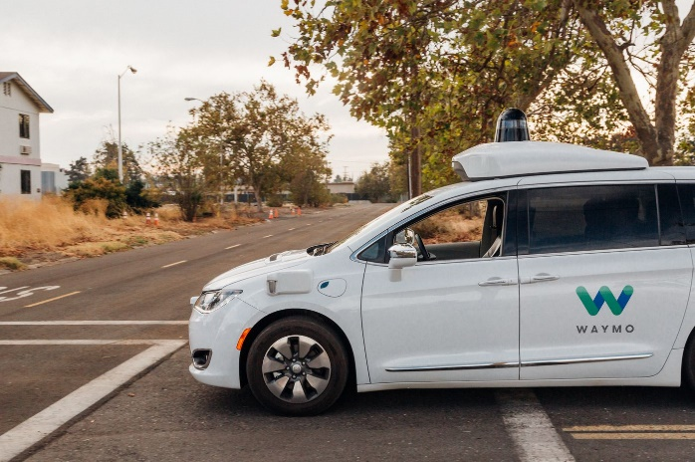



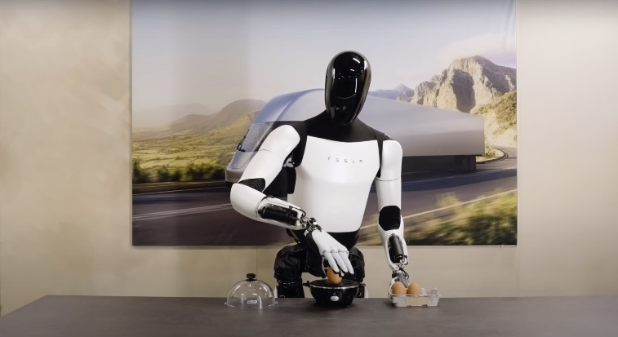

Look Beyond the Negatives
Robotaxis
World's Longest Undersea Cable
World’s Biggest Battery
Longer Life?
Optimus
Agentic AI Agents
Notes:
While the media may be trumpeting the “Crisis Du Jour,” chances are there are positive news stories that just aren’t getting much media attention. These exciting future trends could positively impact investors, despite their lack of coverage in the media.
Robotaxis
Customers are loving self-driving robotaxis in some areas. In August, Waymo provided nearly 500,000 rides in California, a huge jump from under 20,000 the previous year. This year, Uber and Lyft will also offer driverless rides through Waymo and other providers in select locations.
(Source: How Uber and Lyft Are Gearing Up for the Robotaxi Revolution, Forbes, 1/6/25)
Meta Will Build the World's Longest Undersea Cable
Meta’s launched the Waterworth Project, an ambitious plan to lay 31,000 miles of undersea cable connecting five continents. It’s a huge, multibillion-dollar, multi-year effort to improve the world’s digital highways by creating three new oceanic corridors with high-speed, reliable connectivity, and powering AI innovation.This bold move promises to reshape digital infrastructure globally.
(Source: Meta Will Build the World's Longest Undersea Cable, Wired, 2/19/25)
America Is Building the World's Biggest Battery—And It Will Run on Rust
Maine is about to host the world’s largest clean-energy battery. With an impressive 8,500 MWh capacity, it can deliver 85 MW of power for up to 100 hours—enough to light up roughly 670 homes per MW. Expected to be operational in 2028, this cutting-edge system uses rust for long-term storage, providing New England with multi-day clean energy backup and reliability.
(Source: America Is Building the World's Biggest Battery—And It Will Run on Rust, Popular Mechanics, 12/12/24)
Longer Life? Substances That May Slow Aging Discovered With New AI Tool
AgeXtend is an amazing AI platform that's revolutionizing longevity research. It has analyzed over 1.1 billion different molecular compounds and found some that might help slow down aging and improve overall health. This breakthrough tool may not only be useful for discovering new drugs but also for creating personalized medicine. In short, AgeXtend is opening up new ways to understand aging and helping people live longer, healthier lives.
(Source: 'Numerous' Substances That May Slow Aging Discovered With New AI Tool, Newsweek, 12/6/24)
Tesla Optimus
In 2024 Tesla unveiled Optimus—a sci-fi android with George Clooney’s charm and Einstein-level smarts. Seen chatting and taking drink orders at events, it’s built to do it all. From teaching and babysitting to walking your dog and running errands, Optimus is designed to be your all-in-one helper. It’s set to transform everyday life, and it’s going to be awesome.
(Source: Why the Tesla ‘Optimus’ Robot Changes Everything About Customer Experience, CMS Wire, 10/17/24)
Agentic AI Agents
While generative AI focuses on creating, agentic AI is all about doing. AI agentic agents can make decisions, take actions, and adapt to changing environments. It can plan your overseas trip, serve as virtual caregivers, and optimize supply chains in real time. These AI agents think like humans, autonomously solving problems and transforming industries from travel to healthcare, ushering in a new era of innovation and progress.
(Source: Generative AI Vs. Agentic AI: The Key Differences Everyone Needs To Know, Forbes, 2/3/25)
Next, let’s look at what can happen to our investment returns if we focus too much on the negative and not as much on the positive.

Slide 21
Penalties of Missing the Market
Penalties of Missing the Market’s Best Months
S&P 500 Index Average Annual Total Returns: 1995-2024
Penalties of Missing the Market’s Best Days
S&P 500 Index Average Annual Total Returns: 1995-2024
Past performance does not guarantee future results. For illustrative purposes only. Indices are unmanaged and not available for direct investment.
Data Sources: Ned Davis Research and Hartford Funds, 2/24.
Notes:
If we overlook the positive headlines and focus more on the negative ones, we may be tempted to get out of the market. That can have a significant impact on our returns.
Avoiding the market’s downs may mean missing the market’s ups. What are the consequences of missing some of the best months or days? If you miss too many, you would do better to invest in lower-risk Treasury Bills.
Looking at these returns, we see the cost associated with missing some of the best months or days of the market. On the left-hand graph, we start with an average return of [read result]. And we see that if we missed the best 5 months, 10 months, 15 months, etc., how that return goes down. [Read results.]
On the right-hand graph, we see the effects of missing some of the market’s best days.
In both graphs, we would have lost money because we were sitting on the sidelines.
There's a significant cost to trying to time the market. Our suggestion is to have a goal-based plan and stick with it throughout time and not feed into those emotions that can cause us to get off track.

Slide 22
Trying to Avoid a Bear Market Can Hurt Returns
S&P 500 Index 50 Best Days: 1995-2024
Data Source: Ned Davis Research and Hartford Funds, 1/16/25
Notes:
Historically, market timers seeking to avoid the downturn of a bear market would have missed the majority of the market’s best days. (The effects of missing the 50 best days are shown in the pie chart on the slide.) Most of the best days occurred during a bear market or within the first two months of a bull market, when it’s impossible to tell whether a bull has truly arrived. From 1995 to 2024, half of the market’s best days occurred during a bear market.
Essentially, during this time frame, if we pulled our dollars out of equities and we sat in cash investments, we missed some of the best days of the market, and that can have significant negative impact on our overall return.

Slide 23
Individual Investors Have Underperformed
Average Annual Returns for the 30-Year Period Ended 12/31/2024
Data Source: DALBAR’s Annual Quantitative Analysis of Investor Behavior (QAIB), 2025. Performance data for indices represents a lump sum investment in January 1995 to December 2024 with no withdrawals. Stocks are represented by the S&P 500 Index. Bonds are represented by the Bloomberg US Aggregate Bond Index. Past performance does not guarantee future results. Performance data for indices represents a lump-sum investment in January 1995 to December 2024 with no withdrawals. Indices are unmanaged, unavailable for direct investment, and do not reflect fees, expenses, or sales charges.
See last slide for index descriptions.
Dalbar’s Quantitative Analysis of Investor Behavior Methodology ― Dalbar’s Quantitative Analysis of Investor Behavior uses data from the Investment Company Institute (ICI), Standard & Poor’s and Bloomberg’s Index Products to compare mutual fund investor returns to an appropriate set of benchmarks. Covering the period from January 1, 1995, to December 31, 2024, the study utilizes mutual fund sales, redemptions and exchanges each month as the measure of investor behavior. These behaviors reflect the “average investor.” Based on this behavior, the analysis calculates the “average investor return” for various periods. These results are then compared to the returns of respective indices.
Average equity investor and average bond investor performance results are calculated using data supplied by the Investment Company Institute. Investor returns are represented by the change in total mutual fund assets after excluding sales, redemptions and exchanges. This method of calculation captures realized and unrealized capital gains, dividends, interest, trading costs, sales charges, fees, expenses and any other costs. After calculating investor returns in dollar terms, two percentages are calculated for the period examined: Total investor return rate and annualized investor return rate. Total investor return rate is determined by calculating the investor return dollars as a percentage of the net of the sales, redemptions, and exchanges for each period.
Notes:
This may be the most important slide because you can see the average performance over the last 30 years of both the stock market and the bond market compared to the returns of individual investors. On average, the equity market, shown as the light blue bar, has returned [read slide] and the bond market shown as the green bar returned about [read slide]. The average equity investor only had a [read slide] return and the average fixed income investor only had a [read slide] return.
Why is that?
It can be caused by our tendency to buy high and sell low. Many investors buy high because they get exuberant about investment categories that are doing well and they might load up on those right before they make a downward turn. Or, as we saw with our panic investors a few slides ago they sell low by getting out of the market at the bottom when a recovery is about to begin. And the media news stories influence our tendency to make these kind of decisions that hurt long-term results.
So, as you can see, investor behavior may be more important than investment performance when it comes to long-term results.
Let’s recap what we covered today.

Slide 24

Summary
Summary
Anxiety
We’re becoming
more anxious
Instinctual Behavior
The price of panic
Staying Above
the Fray
Look beyond
the negatives
Notes:
To summarize, today we discussed [read points]
24

Slide 25


THE BOTTOM LINE
“How many times does the end of the world as we know it need to arrive before we realize that it’s not the end of the world as we know it?”
Michael Lewis
Best-selling author of “The Big Short”
Notes:
Here’s the bottom line. (read slide)

Slide 26
Next Steps
Review the Media Replay brochure
Schedule an appointment with your financial professional
Discuss your portfolio asset allocation
MF916
Notes:
If this presentation makes sense, here are your next steps: [read slide]
26

Slide 27
Important Risks: Investing involves risk, including the possible loss of principal. Fixed income security risks include credit, liquidity, call, duration, event and interest-rate risk. As interest rates rise, bond prices generally fall. • Diversification does not ensure a profit or protect against loss.
Index Descriptions:
Indices are unmanaged and unavailable for direct investment and do not represent the performance of any Hartford Funds.
Dow Jones Industrial Average is a price-weighted average of 30 significant stocks traded on the New York Stock Exchange and the Nasdaq.
S&P 500 Index is a market capitalization-weighted price index composed of 500 widely held common stocks.
IA SBBI LT Government Index measures the performance of a single issue of outstanding US Treasury notes with a maturity term of around 5.5 years.
Bloomberg U.S. Aggregate Bond Index is comprised of government securities, mortgage-backed securities, asset backed securities, and corporate securities to simulate the universe of bonds in the market.
Bloomberg U.S. Treasury Bill (1-3 Months) Index tracks the performance of all outstanding 0-3 month outstanding Treasury Bills issued by the US government.
From TIME. © 1980, 1981, 1983, 1984, 1995, 1999, 2008, 2016, 2022 TIME USA LLC. All rights reserved. Used under license.
“Bloomberg®” and any Bloomberg Index are service marks of Bloomberg Finance L.P. and its affiliates, including Bloomberg Index Services Limited (“BISL”), the administrator of the indices (collectively, “Bloomberg”) and have been licensed for use for certain purposes by Hartford Funds. Bloomberg is not affiliated with Hartford Funds, and Bloomberg does not approve, endorse, review, or recommend any Hartford Funds product. Bloomberg does not guarantee the timeliness, accurateness, or completeness of any data or information relating to Hartford Fund products.
Hartford Mutual Funds may or may not be invested in the companies referenced in this presentation. No particular endorsement or recommendation of any product or service is being made.
The MIT AgeLab is not an affiliate or subsidiary of Hartford Funds.
SEM_MR 0325 4329653

